Slide 1
UPPER SIXTH ARTS
GEOGRAPHY
Lesson 2
Population Distribution and Density
Notes:
Good morning, class, and welcome to our geography lesson. I am your geography teacher, Mr Kamdem. Today we are starting Lesson 2: Population Distribution and Density.

Slide 2
CLASS INFO
Class, Chapter and Duration
Class | Upper Sixth Arts
Chapter | Module 4: Understanding and managing population dynamics across the world in general and Cameroon in particular
Duration | 2 periods (2 × 50 minutes)
Notes:
This lesson is for Upper Sixth Arts. It belongs to Module 4: Understanding and managing population dynamics across the world in general and Cameroon in particular. We shall need 2 periods to cover it.

Slide 3
IDENTIFICATION
Lesson Identification
Topic | Population Numbers
Sub-topic | Population Density and Distribution
Lesson | Lesson 2: Population Distribution and Density
Notions / Concepts | Population distribution, unevenness, continentality, insularity, population density, arithmetic density, physiological density, agricultural density.
Syllabus focus | Meaning and concept of population distribution; levels of unevenness (continental, national, latitudinal, vertical, coastal); population density and its types; measurement; usefulness.
Competence | Learners are able to describe the unevenness of population distribution at different levels and to calculate and use the three types of population density.
Notes:
Our topic is Population Numbers, and the sub-topic is Population Density and Distribution. The key notions we shall use today are: population distribution, unevenness, continentality, insularity, population density, arithmetic density, physiological density, agricultural density. At the end, you should be able to do this: learners are able to describe the unevenness of population distribution at different levels and to calculate and use the three types of population density.

Slide 4

HOMEWORK CORRECTION
Correction of the Homework
Question (Lesson 1: Sources of Population Data):
Define population density.
Notes:
Before we start the new lesson, let us correct the homework I gave you at the end of Lesson 1: Sources of Population Data. The question was: Define population density. Take out your exercise books.

Slide 5
HOMEWORK CORRECTION
Correction: Possible Answer
Population density is the number of people living per unit area, usually per square kilometre.
Notes:
Here is a good answer. Population density is the number of people living per unit area, usually per square kilometre. Compare it with your own answer and correct your work in red.

Slide 6
LESSON PLAN
Lesson Plan
Correction of the homework
Objectives and recall
Real-life situation and action to take
Learning activities
Board summary
Evaluation, remediation and homework
Notes:
Here is the plan of our lesson today. First, we shall correct the homework. Then we shall look at the objectives and recall what you already know. After that, we shall study a situation from real life and the action to take, and do the learning activities. Finally, we shall copy the board summary, do the evaluation and the remediation, and I will give you the homework.

Slide 7
OBJECTIVES
Objectives
By the end of this lesson, you should be able to:
Define population distribution and population density.
Describe the unevenness of population distribution at the continental, national, latitudinal, vertical and coastal levels.
Notes:
Take your time to copy this part; we will continue together.

Slide 8
OBJECTIVES
Objectives (continued)
Calculate arithmetic, physiological and agricultural densities.
Evaluate the usefulness of distribution and density data.
Notes:
By the end of this lesson, you should be able to do four things. Number 1: define population distribution and population density. Number 2: describe the unevenness of population distribution at the continental, national, latitudinal, vertical and coastal levels. Number 3: calculate arithmetic, physiological and agricultural densities. Number 4: evaluate the usefulness of distribution and density data.

Slide 9
PREVIOUS KNOWLEDGE
Previous Knowledge
A census counts every person of a country.
Asia has about 60 % of the world population.
Cameroon has an area of about 475,650 km².
Notes:
Let us first remember what you already know. A census counts every person of a country. Asia has about 60 % of the world population. Cameroon has an area of about 475,650 km². Keep this in mind, because we shall build on it today.

Slide 10
REAL-LIFE SITUATION
Situation in Real Life
The Littoral Region has about 190 people per km² while the East Region has only about 11 people per km².
A company wants to open a supermarket and a new bus line and hesitates between Douala and Bertoua.
Notes:
Take your time to copy this part; we will continue together.

Slide 11
REAL-LIFE SITUATION
Situation in Real Life (continued)
The manager asks: "How are people spread across Cameroon and the world, and how can we measure how crowded an area is?"
Notes:
Listen carefully to this situation from real life. The Littoral Region has about 190 people per km² while the East Region has only about 11 people per km². A company wants to open a supermarket and a new bus line and hesitates between Douala and Bertoua. The manager asks: "How are people spread across Cameroon and the world, and how can we measure how crowded an area is?" Think about it, because I am going to ask you some questions.

Slide 12
REAL-LIFE SITUATION
Situation: Question 1
What is the problem in the situation?
Notes:
Question 1: What is the problem in the situation? Think for a moment, then raise your hand to answer.

Slide 13
REAL-LIFE SITUATION
Answer
The company does not know how population is distributed and how to measure density.
Notes:
Good. The company does not know how population is distributed and how to measure density.

Slide 14
REAL-LIFE SITUATION
Situation: Question 2
Which region is more crowded?
Notes:
Question 2: Which region is more crowded? Think for a moment, then raise your hand to answer.

Slide 15
REAL-LIFE SITUATION
Answer
The Littoral Region (about 190 people per km²).
Notes:
Good. The Littoral Region (about 190 people per km²).

Slide 16
REAL-LIFE SITUATION
Situation: Question 3
Where should the supermarket go first?
Notes:
Question 3: Where should the supermarket go first? Think for a moment, then raise your hand to answer.

Slide 17
REAL-LIFE SITUATION
Possible Answer
In Douala, where many customers live close together.
Notes:
Good. In Douala, where many customers live close together.

Slide 18
ACTION TO TAKE
Action to Take
Use density figures before choosing where to build a school, a market or a health centre.
Notes:
From this situation, the action we are working towards in this lesson is the following: use density figures before choosing where to build a school, a market or a health centre.

Slide 19
JUSTIFICATION
Justification of the Lesson
This lesson helps us to understand why people are unevenly spread and to use density figures to plan services and investments.
Notes:
Why is this lesson important for you? This lesson helps us to understand why people are unevenly spread and to use density figures to plan services and investments.

Slide 20
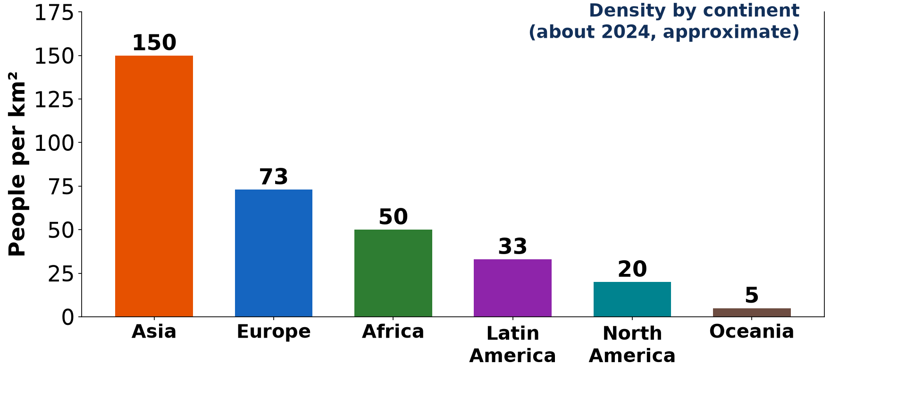
1. CONTINENTAL LEVEL
Activity 1
Density by continent.
Notes:
Activity 1. Look carefully at this picture: density by continent. Observe every detail before I ask the question.

Slide 21
1. CONTINENTAL LEVEL
Activity 1: Question
Which continent is the most densely populated?
Notes:
Here is the question for Activity 1: Which continent is the most densely populated? Take one minute to think and write your answer in your rough notebook.

Slide 22
1. CONTINENTAL LEVEL
Activity 1: Answer
Asia (about 150 people per km²).
Notes:
Let us check the answer together. Asia (about 150 people per km²).

Slide 23
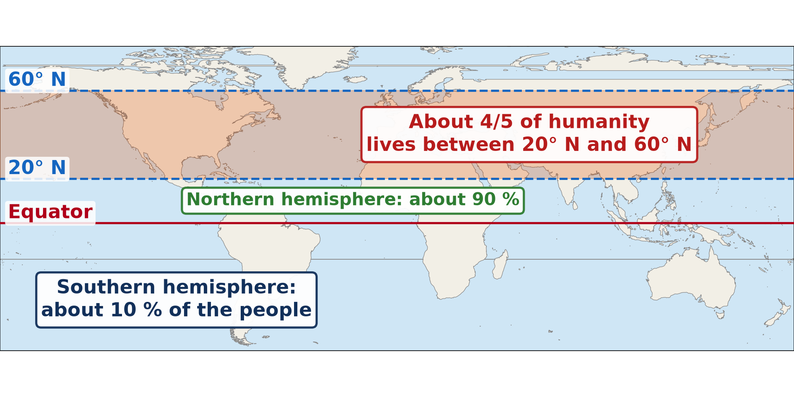
1. LATITUDINAL LEVEL
Activity 2
Population by latitude.
Notes:
Activity 2. Look carefully at this picture: population by latitude. Observe every detail before I ask the question.

Slide 24
1. LATITUDINAL LEVEL
Activity 2: Question
In which hemisphere do about 90 % of people live?
Notes:
Here is the question for Activity 2: In which hemisphere do about 90 % of people live? Take one minute to think and write your answer in your rough notebook.

Slide 25
1. LATITUDINAL LEVEL
Activity 2: Answer
In the northern hemisphere.
Notes:
Let us check the answer together. In the northern hemisphere.

Slide 26
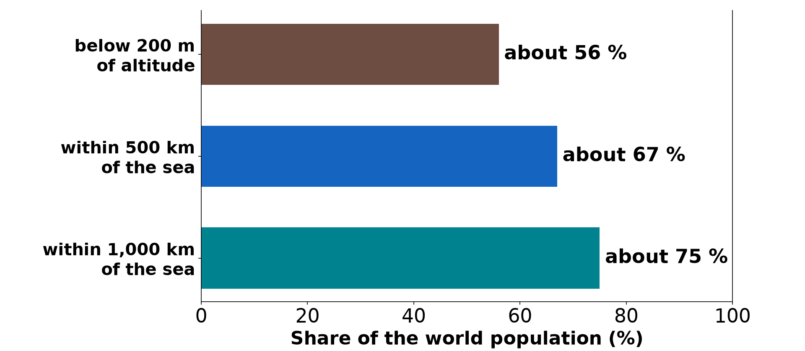
1. VERTICAL AND COASTAL LEVELS
Activity 3
Altitude, the sea and population.
Notes:
Activity 3. Look carefully at this picture: altitude, the sea and population. Observe every detail before I ask the question.

Slide 27
1. VERTICAL AND COASTAL LEVELS
Activity 3: Question
About what share of humanity lives within 500 km of the sea?
Notes:
Here is the question for Activity 3: About what share of humanity lives within 500 km of the sea? Take one minute to think and write your answer in your rough notebook.

Slide 28
1. VERTICAL AND COASTAL LEVELS
Activity 3: Answer
About two-thirds.
Notes:
Let us check the answer together. About two-thirds.

Slide 29
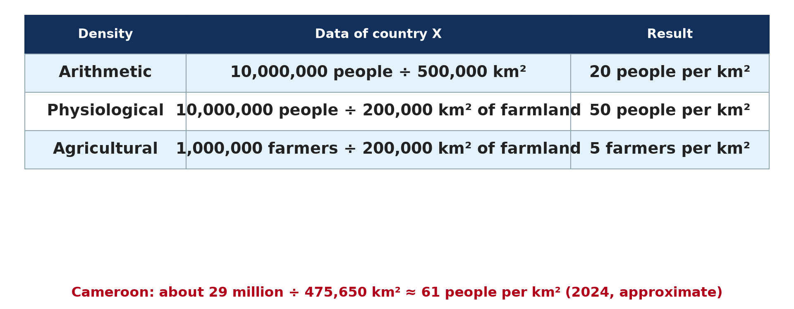
2. TYPES OF DENSITY
Activity 4
Three types of density.
Notes:
Activity 4. Look carefully at this picture: three types of density. Observe every detail before I ask the question.

Slide 30
2. TYPES OF DENSITY
Activity 4: Question
Calculate the density of a country with 10 million people on 500,000 km².
Notes:
Here is the question for Activity 4: Calculate the density of a country with 10 million people on 500,000 km². Take one minute to think and write your answer in your rough notebook.

Slide 31
2. TYPES OF DENSITY
Activity 4: Answer
10,000,000 ÷ 500,000 = 20 people per km² (arithmetic density).
Notes:
Let us check the answer together. 10,000,000 ÷ 500,000 = 20 people per km² (arithmetic density).

Slide 32

3. USEFULNESS
Activity 5
A crowded street.
Notes:
Activity 5. Look carefully at this picture: a crowded street. Observe every detail before I ask the question.

Slide 33
3. USEFULNESS
Activity 5: Question
Give one use of density data for a town council.
Notes:
Here is the question for Activity 5: Give one use of density data for a town council. Take one minute to think and write your answer in your rough notebook.

Slide 34
3. USEFULNESS
Activity 5: Answer
To decide where to build schools, parks, markets or health centres.
Notes:
Let us check the answer together. To decide where to build schools, parks, markets or health centres.

Slide 35
BOARD SUMMARY
Board Summary
Topic: Population Numbers
Sub-topic: Population Density and Distribution
Lesson 2: Population Distribution and Density
Notes:
Now we are going to copy the board summary. Write the title and the headings neatly in your notebooks. I will give you enough time for each slide, so do not rush.

Slide 36
BOARD SUMMARY
DEFINITIONS
The key terms of this lesson are defined as follows:
Population distribution: It is the way people are spread over an area, showing where they are concentrated and where they are scattered.
Notes:
Let us copy the definitions. The key terms of this lesson are defined as follows. On this slide we have Population distribution. Write each point on a new line, with the key term first, and explain it in your own words when we revise. When you finish, we go to the next slide.

Slide 37
BOARD SUMMARY
DEFINITIONS (continued)
Population density: It is the number of people living per unit area, usually per square kilometre.
Continentality: It is the effect of distance from the sea: areas far inland are generally less populated.
Notes:
We continue with the definitions. On this slide we have Population density and Continentality. Write each point on a new line, with the key term first, and explain it in your own words when we revise. When you finish, we go to the next slide.

Slide 38
BOARD SUMMARY
DEFINITIONS (continued)
Insularity: It is the condition of being an island or near the coast, which often attracts people.
Notes:
We continue with the definitions. On this slide we have Insularity. Write each point on a new line, with the key term first, and explain it in your own words when we revise.

Slide 39
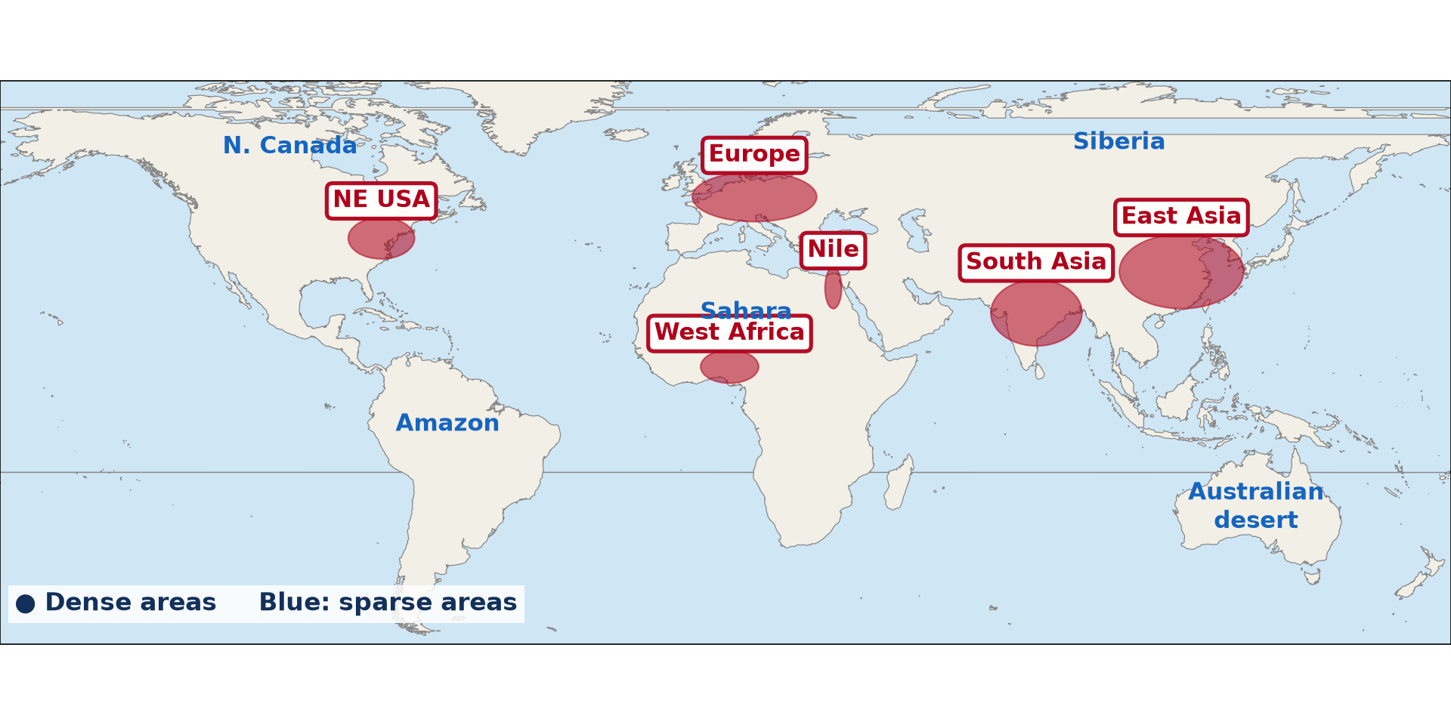
BOARD SUMMARY
1. The Unevenness of Population Distribution
A) Continental and National Levels
The unevenness of population at the continental and national levels is the following:
Uneven spread: The world population is very unevenly spread: a few regions are crowded and large areas are almost empty.
Illustration: dense and sparse areas of the world
Notes:
Let us copy Continental and National Levels. The unevenness of population at the continental and national levels is the following. Copy the point on Uneven spread on the left, then draw the diagram on the right: dense and sparse areas of the world. Give it a title and label it clearly.

Slide 40
BOARD SUMMARY
1. The Unevenness of Population Distribution
A) Continental and National Levels
Continental level: Asia is the densest continent (about 150 per km²), while Oceania has only about 5 per km².
Illustration: density by continent
Notes:
Copy the point on Continental level on the left, then draw the diagram on the right: density by continent. Give it a title and label it clearly.

Slide 41
BOARD SUMMARY
1. The Unevenness of Population Distribution
A) Continental and National Levels
Very large countries: About fifteen countries have more than 100 million people, such as India, China, the USA, Indonesia, Pakistan and Nigeria.
Notes:
We continue with Continental and National Levels. On this slide we have Very large countries. Write each point on a new line, with the key term first, and explain it in your own words when we revise. When you finish, we go to the next slide.

Slide 42
BOARD SUMMARY
1. The Unevenness of Population Distribution
A) Continental and National Levels (continued)
Very small countries: Some countries have fewer than 2 million people, such as Guyana, Equatorial Guinea, Eswatini and Djibouti.
Notes:
We continue with Continental and National Levels. On this slide we have Very small countries. Write each point on a new line, with the key term first, and explain it in your own words when we revise.

Slide 43

BOARD SUMMARY
1. The Unevenness of Population Distribution
A) Continental and National Levels
Inside Cameroon: The Littoral, West and Far North Regions are dense, while the East and South Regions are sparsely populated.
Illustration: density by region in Cameroon
Notes:
Copy the point on Inside Cameroon on the left, then draw the diagram on the right: density by region in Cameroon. Give it a title and label it clearly.

Slide 44
BOARD SUMMARY
1. The Unevenness of Population Distribution
B) Latitudinal, Vertical and Coastal Levels
The unevenness of population by latitude, altitude and distance from the sea is the following:
Latitudinal distribution: About 90 % of people live in the northern hemisphere, mostly between 20° N and 60° N.
Illustration: population by latitude
Notes:
Let us copy Latitudinal, Vertical and Coastal Levels. The unevenness of population by latitude, altitude and distance from the sea is the following. Copy the point on Latitudinal distribution on the left, then draw the diagram on the right: population by latitude. Give it a title and label it clearly.

Slide 45
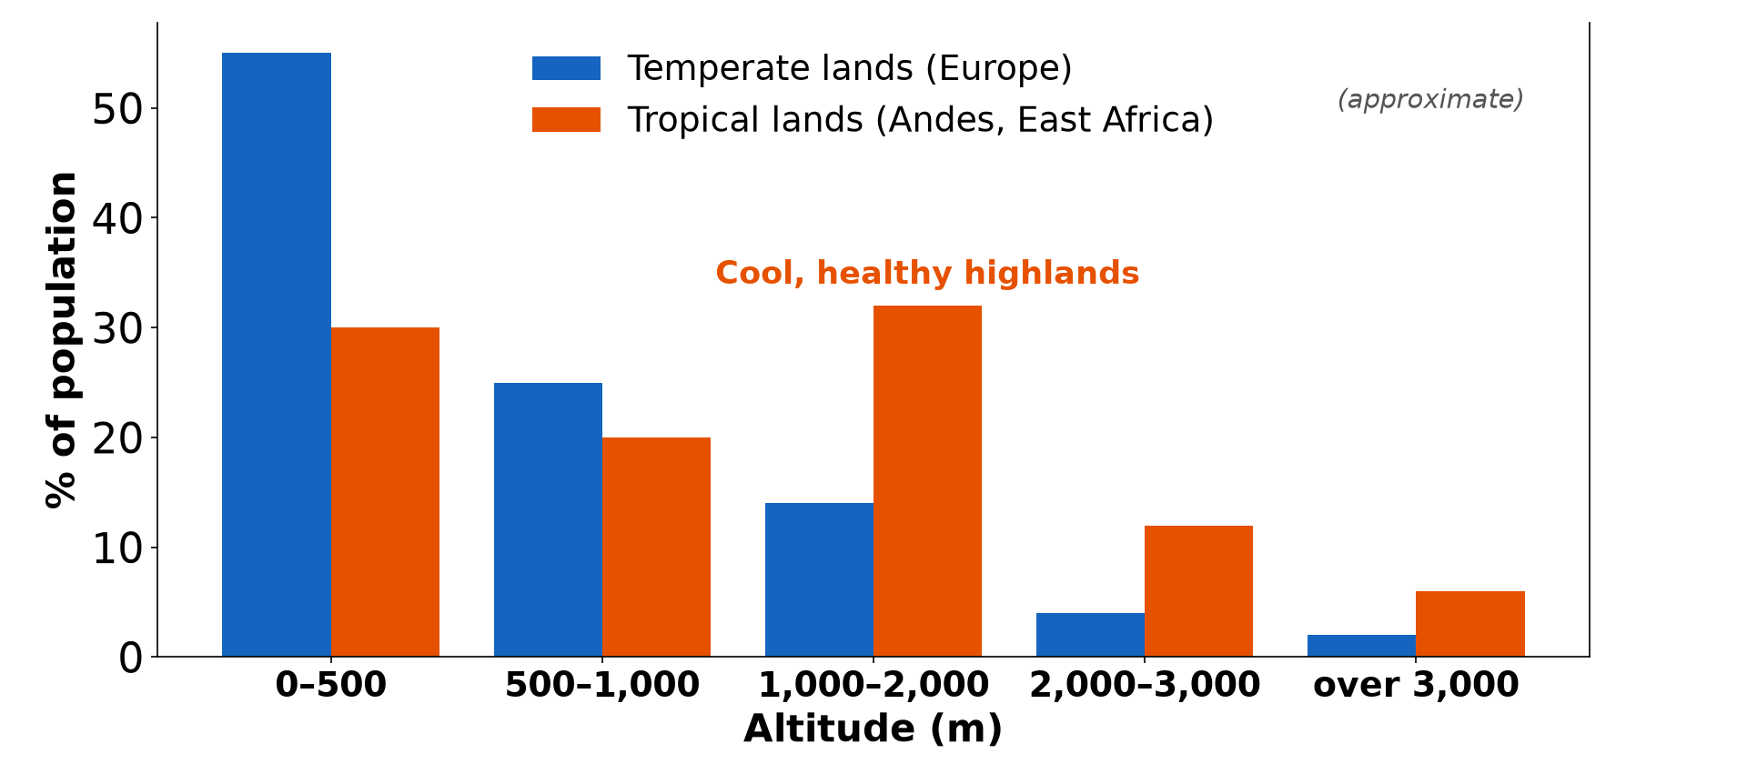
BOARD SUMMARY
1. The Unevenness of Population Distribution
B) Latitudinal, Vertical and Coastal Levels
Vertical distribution: Density generally falls with altitude: about 56 % of people live below 200 m, and about four-fifths live below 500 m.
Illustration: population and altitude
Notes:
Copy the point on Vertical distribution on the left, then draw the diagram on the right: population and altitude. Give it a title and label it clearly.

Slide 46
BOARD SUMMARY
1. The Unevenness of Population Distribution
B) Latitudinal, Vertical and Coastal Levels
Tropical exception: In the tropics, cool highlands such as the Ethiopian Highlands and the Western Highlands of Cameroon are densely populated.
Notes:
We continue with Latitudinal, Vertical and Coastal Levels. On this slide we have Tropical exception. Write each point on a new line, with the key term first, and explain it in your own words when we revise.

Slide 47
BOARD SUMMARY
1. The Unevenness of Population Distribution
B) Latitudinal, Vertical and Coastal Levels
Coastal distribution: About two-thirds of the world population lives within 500 km of the sea, and about three-quarters within 1,000 km.
Illustration: altitude, coast and population
Notes:
Copy the point on Coastal distribution on the left, then draw the diagram on the right: altitude, coast and population. Give it a title and label it clearly.

Slide 48
BOARD SUMMARY
1. The Unevenness of Population Distribution
B) Latitudinal, Vertical and Coastal Levels
Example: Douala, Lagos and Abidjan are large coastal cities, while the interior of the Sahara and Central Africa is thinly populated.
Notes:
We continue with Latitudinal, Vertical and Coastal Levels. On this slide we have Example. Write each point on a new line, with the key term first, and explain it in your own words when we revise.

Slide 49
BOARD SUMMARY
2. Population Density and its Types
The types of population density and their calculation are the following:
Arithmetic (crude) density: It is the total population divided by the total land area; 10 million people on 500,000 km² give 20 people per km².
Illustration: three types of density
Notes:
Let us copy Population Density and its Types. The types of population density and their calculation are the following. Copy the point on Arithmetic (crude) density on the left, then draw the diagram on the right: three types of density. Give it a title and label it clearly.

Slide 50
BOARD SUMMARY
2. Population Density and its Types
Physiological density: It is the total population divided by the area of cultivable land; 10 million people on 200,000 km² of farmland give 50 people per km².
Notes:
We continue with Population Density and its Types. On this slide we have Physiological density. Write each point on a new line, with the key term first, and explain it in your own words when we revise. When you finish, we go to the next slide.

Slide 51
BOARD SUMMARY
2. Population Density and its Types (continued)
Agricultural density: It is the number of farmers divided by the area of cultivable land; 1 million farmers on 200,000 km² give 5 farmers per km².
Meaning of each:
Arithmetic density shows the general crowding.
Notes:
We continue with Population Density and its Types. On this slide we have Agricultural density and Meaning of each. Write each point on a new line, with the key term first, and explain it in your own words when we revise. When you finish, we go to the next slide.

Slide 52
BOARD SUMMARY
2. Population Density and its Types (continued)
Physiological density shows the pressure on farmland.
Agricultural density shows how efficient farming is.
Cameroon: About 29 million people on 475,650 km² give an arithmetic density of about 61 people per km².
Notes:
We continue with Population Density and its Types. On this slide we have Cameroon. Write each point on a new line, with the key term first, and explain it in your own words when we revise.

Slide 53
BOARD SUMMARY
2. Population Density and its Types
Measurement
Population distribution and density are measured with the following tools:
Census data: They give the number of people in each region, division and district.
Notes:
Let us copy Measurement. Population distribution and density are measured with the following tools. On this slide we have Census data. Write each point on a new line, with the key term first, and explain it in your own words when we revise.

Slide 54
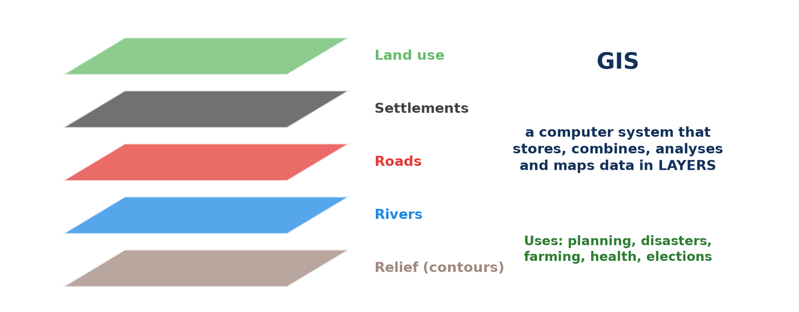
BOARD SUMMARY
2. Population Density and its Types
Measurement
Geographic Information Systems (GIS): They combine population figures with maps and satellite images to map density precisely.
Illustration: GIS layers
Notes:
Copy the point on Geographic Information Systems (GIS) on the left, then draw the diagram on the right: gIS layers. Give it a title and label it clearly.

Slide 55
BOARD SUMMARY
2. Population Density and its Types
Measurement
Surveys: They give density figures for small areas such as a neighbourhood or a village.
Notes:
We continue with Measurement. On this slide we have Surveys. Write each point on a new line, with the key term first, and explain it in your own words when we revise.

Slide 56
BOARD SUMMARY
3. Usefulness of Distribution and Density Data
Distribution and density data are useful in the following ways:
Urban planning: They show where to build roads, schools, markets and parks, as in the crowded quarters of Douala.
Illustration: a crowded street
Notes:
Let us copy Usefulness of Distribution and Density Data. Distribution and density data are useful in the following ways. Copy the point on Urban planning on the left, then draw the diagram on the right: a crowded street. Give it a title and label it clearly.

Slide 57
BOARD SUMMARY
3. Usefulness of Distribution and Density Data
Resource management: They help to share water, electricity, transport and health care according to needs.
Economic development: Investors use them to choose where to open shops, banks and factories.
Notes:
We continue with Usefulness of Distribution and Density Data. On this slide we have Resource management and Economic development. Write each point on a new line, with the key term first, and explain it in your own words when we revise. When you finish, we go to the next slide.

Slide 58
BOARD SUMMARY
3. Usefulness of Distribution and Density Data (continued)
Environmental management: They show where human pressure threatens forests, soils and water.
Notes:
We continue with Usefulness of Distribution and Density Data. On this slide we have Environmental management. Write each point on a new line, with the key term first, and explain it in your own words when we revise.

Slide 59
FORMATIVE EVALUATION
Evaluation 1
Distinguish between arithmetic and physiological density.
Notes:
Now let us check what you have understood. Question 1: Distinguish between arithmetic and physiological density. Answer in your exercise book.

Slide 60
FORMATIVE EVALUATION
Expected Answer
Arithmetic density divides the population by the total area; physiological density divides it by the area of cultivable land.
Notes:
The expected answer is: arithmetic density divides the population by the total area; physiological density divides it by the area of cultivable land. If you got it right, well done.

Slide 61
FORMATIVE EVALUATION
Evaluation 2
Give two examples of the unevenness of world population distribution.
Notes:
Now let us check what you have understood. Question 2: Give two examples of the unevenness of world population distribution. Answer in your exercise book.

Slide 62
FORMATIVE EVALUATION
Expected Answer
About 90 % of people live in the northern hemisphere; about two-thirds live within 500 km of the sea.
Notes:
The expected answer is: about 90 % of people live in the northern hemisphere; about two-thirds live within 500 km of the sea. If you got it right, well done.

Slide 63
REMEDIATION
Remediation
Fill in the blanks:
The most densely populated continent is ______.
People ÷ farmland area gives the ______ density.
Notes:
Take your time to copy this part; we will continue together.

Slide 64
REMEDIATION
Remediation (continued)
About ______ % of humanity lives in the northern hemisphere.
Notes:
For those who need more practice, fill in the blanks in your exercise book. The answers are: number 1, Asia; number 2, physiological; number 3, 90.

Slide 65
HOMEWORK
Homework
Name two types of maps that show population density.
Notes:
For your homework: Name two types of maps that show population density. We shall correct it at the beginning of our next lesson.

Slide 66
NEXT LESSON
Next Lesson
Our next lesson will be on:
Practical Work 1: Techniques of Mapping Population Distribution and Density
Notes:
Our next lesson will be on Practical Work 1: Techniques of Mapping Population Distribution and Density. Thank you for your attention, and see you next time.

Slide 67
BILINGUAL GAME
Bilingual Game (Jeu Bilingue)
English | Français
Population distribution | La répartition de la population
Population density | La densité de population
Sparsely populated | Faiblement peuplé
Densely populated | Densément peuplé
Farmland | Les terres cultivables
Hemisphere | L'hémisphère
Notes:
Let us play the bilingual game. I say a word in English, and you give me the French word. Then we do the reverse.

Slide 68
LOGBOOK
Official Logbook (1/2)
Module / Topic | Population Numbers
Lesson Title | Lesson 2: Population Distribution and Density
Expected Learning Outcomes | Define population distribution and population density. Describe the unevenness of population distribution at the continental, national, latitudinal, vertical and coastal levels. Calculate arithmetic, physiological and agricultural densities. Evaluate the usefulness of distribution and density data.
Competence | Learners are able to describe the unevenness of population distribution at different levels and to calculate and use the three types of population density.
Notes:
I record this information in the official logbook of the class after the lesson.

Slide 69
LOGBOOK
Official Logbook (2/2)
Matter Taught | DEFINITIONS; Continental and National Levels; Latitudinal, Vertical and Coastal Levels; Population Density and its Types; Measurement; Usefulness of Distribution and Density Data.
Evaluation | Formative evaluation and remediation exercise.
Homework | Name two types of maps that show population density.
Enrolment / Present / Absent | ____ / ____ / ____
Achievement | To be completed after the lesson.
Notes:
I complete the second page of the logbook: the matter taught, the evaluation, the homework and the attendance.

Slide 70
TEACHER'S NOTE
Teacher's Note
Timing: Homework correction, plan, objectives 8 min | Recall, situation, action 10 min | 5 activities 30 min | Board summary (copying) 30 min | Evaluation, remediation 10 min | Homework, next lesson 5 min | Logbook 7 min
Without the projector (Activity 1): draw the bars on the board.
Without the projector (Activity 2): draw the Equator and the 20° N and 60° N lines.
Without the projector (Activity 3): write the three percentages on the board.
Without the projector (Activity 4): do the calculation on the board.
Without the projector (Activity 5): describe a crowded market.
Notes:
This slide is for me, the teacher: it gives the timing of the lesson and what to do if the projector is not available.

Slide 71
REFERENCES
References
Geography Syllabus for Sixth Forms (Lower and Upper Sixth), MINESEC, 2019 — Module 4 (Population Geography).
Teacher's course notes: Mr KAMDEM E., Population Geography (USA), GBHS Garoua, 2026.
United Nations, World Population Prospects 2024.
Photo, Activity 5: “Wax market” by zouzouwizman, CC BY 2.0, via Flickr (https://www.flickr.com/photos/61111202@N00/12129001)
Diagrams and animations: drawn for this lesson (Geography Department).
Notes:
These are the references and picture credits used to prepare this lesson.

